Slide 1
Elements of Style
Composition 110

Slide 2
Diction
The writers choice of words
Goal: To choose just the right words for your topic, purpose, and audience and arrange them so the intended meaning is clear and interesting.
There are 4 levels of diction

Slide 3
Formal Diction
Used for official or legal occasions or for some teachers
Characteristics
Advanced vocabulary
Complex sentence structure
Majestic, persuasive, or objective tone
Third-person POV (except speeches)
Standard, formal grammar
Use of parallelism and figurative language

Slide 4
IN CONGRESS, JULY 4, 1776
The unanimous Declaration of the thirteen united States of America
When in the Course of human events it becomes necessary for one people to dissolve the political bands which have connected them with another and to assume among the powers of the earth, the separate and equal station to which the Laws of Nature and of Nature's God entitle them, a decent respect to the opinions of mankind requires that they should declare the causes which impel them to the separation.

Slide 5
Technical Diction
Used to communicate to co-workers in the same field or expertise
Characteristics:
Jargon (specialized vocabulary)
Mostly complex sentences
Objective tone
Third-person POV
Standard grammar
Accompanied by charts, maps, graphs or illustrations
http://manuals.info.apple.com/MANUALS/1000/MA1596/en_US/ipod_touch_user_guide.pdf

Slide 6
Informal Diction
Used for most writing
Characteristics:
Vivid, clear, “grown-up” vocabulary
Variety of sentence structures
Any appropriate tone
First, second, or third person POV
Standard grammar with relaxed rules
Occasional contraction, fragment for effect, slang terms (in quotes)

Slide 7
When my son flopped down on my bed with tears in his eyes, I knew I was in trouble. “Mom, one of my baby rats needs to see the vet,” he said. A week before, the female rat—way too young, in my naive view, to be sexually active—he had brought home from the pet store had given birth to 10 hairless babies, each the size of a pistachio. One baby was in distress: a teeny hair, invisible to the naked eye, had wrapped around its toe and cut off circulation. A local veterinarian could see him/her immediately. No idea of its gender. Ninety minutes and $85 later, we returned home with our recovering patient, hair gone. Just apply Neosporin to the infected toe, the vet said. But keep an eye on the injury; if it gets worse, we might need to amputate.

Slide 8
Colloquial/Slang Diction
Used only for creative writing, dialogue, or special effect
Characteristics:
Regional words with altered spelling
Many fragments and simple sentences
First or third person POV
Non-standard grammar
Frequent use of contractions and slang

Slide 9
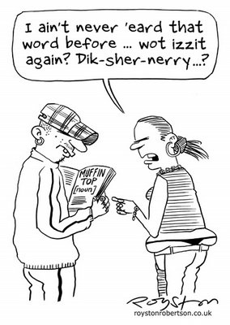
http://www.youtube.com/watch?v=A98tf9krihg

Slide 10
Note
Phrases such as “kids,” “a lot,” and “got” are considered colloquial.
Avoid them in informal writing situations

