Slide 1
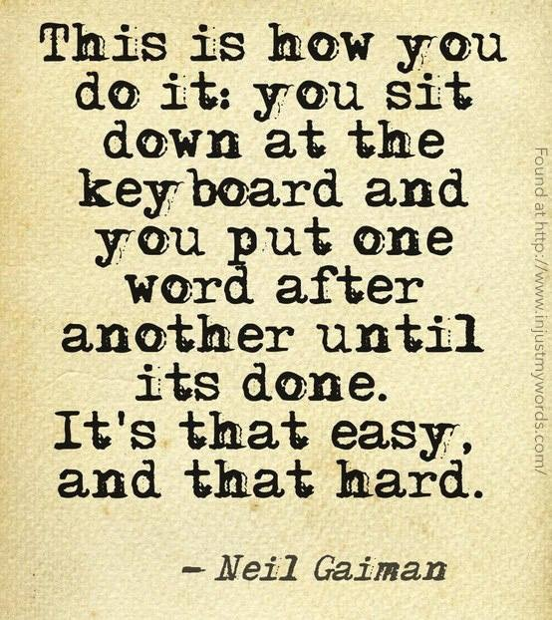
Composition 110 Introductory Notes

Slide 2
Why Write?
Writing helps you sort things out
“How do I know what I think until I see what I say?” E.M. Forster
Writing helps persuade others and fight oppression
Writing makes you smarter
Clear, concise writing is essential to get into and through college
Writing prepares you for any field of work
http://www.youtube.com/watch?v=L7hbR-MivtQ

Slide 3
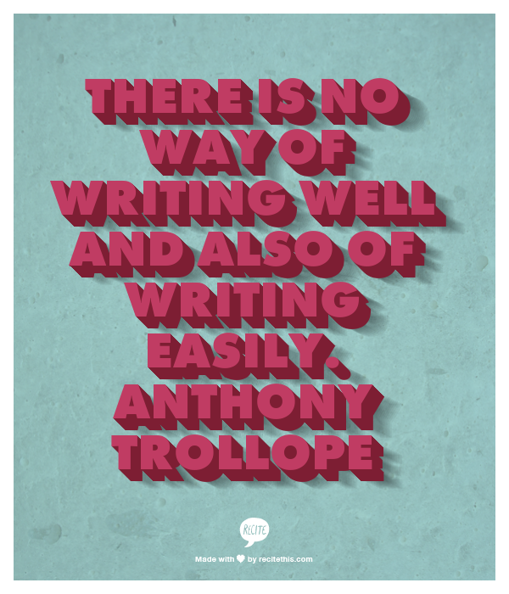
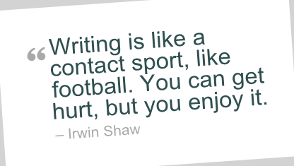
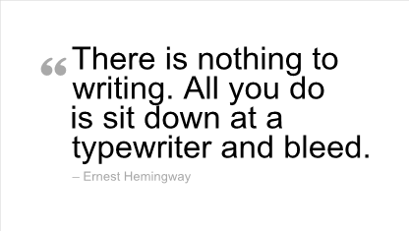
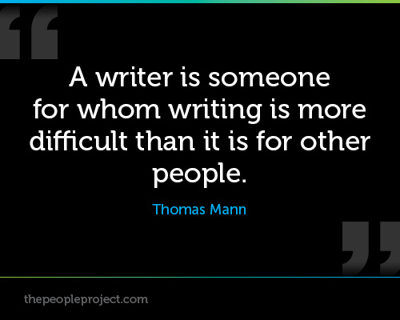
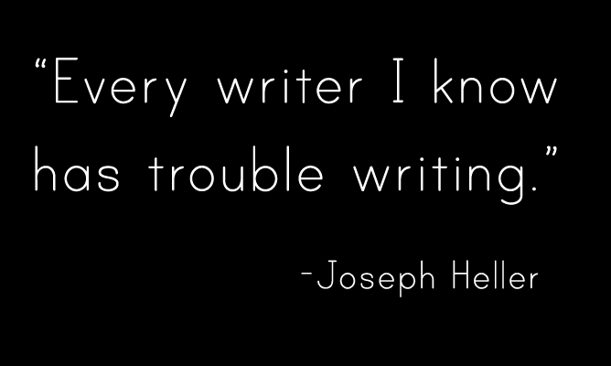
Writing is HARD!
But “hard” is rewarding!

Slide 4
But…

Slide 5
Advantages of Writing
More permanent than speaking
Gives time for the writer to choose exactly the right wording
May help readers absorb information better
Less likely to be interrupted with argument or off-topic info.

Slide 7
Disadvantages of Writing
Loss of voice capabilities (pitch, tone, volume, pacing)
Readers may choose to stop reading
Poor writing leaves a stronger negative impression than poor speech
Requires more time, effort, and thought
Requires resources (pen, paper, computer, etc.)
Writing is more permanent than speaking ☺

Slide 9
Pop Quiz!
When a writer decides to communicate IDEAS and FEELINGS, careful writing will always be more precise and effective than speaking.
TRUE FALSE

Slide 10
Purposes of Writing
General To Inform/Explain: give information
To Persuade/Take a Stand: inspire or cause to agree
To Express/Reflect: relate personal ideas/personality
To Entertain: amuse or move readers
Specific The exact purpose for writing (thesis)
Example: general purpose – to inform & persuade
specific purpose – to relate to readers the dangers of second-hand smoke and encourage them to support a public smoking ban.

Slide 12
Audience
A writer should adapt style to the audience. What words, images, information will be most effective?
A writer should not compromise values or beliefs. Your message should not change to suit the audience.
Elements to consider before writing: Age? Education level? Social status? Purpose? Knowledge of topic? Likely response to subject?

Slide 14
Pop Quiz!
It is possible and appropriate to have more than one purpose when composing a piece of writing.
TRUE FALSE

Slide 15
Qualities of Good Writing
Originality: saying something new or in a new way
http://www.ted.com/talks/kirby_ferguson_embrace_the_remix
Style: clear, vivid word choice, imagery, and structures that are appropriate for audience

Slide 16
Qualities of Good Writing
Organization: how the writing is presented
Introduction: grabs reader’s attention, identifies the topic ,and sets the tone
Body: delivers the message, supports ideas with variety of details, and connects ideas
Conclusion: insightful comments to wrap up the topic and makes a memorable closing statement

Slide 18
Pop Quiz
Every essay must include which of the following? Mark ALL that apply
Introduction that identifies the topic and tone
A preview of main points in an introductory thesis statement
Transitions to connect ideas
Supported ideas with a variety of details
Explanation of the essay’s purpose
A “hook” or attention getter
A message to the reader

Slide 19
Relationships
Writer
Audience
Message
Writer decides FORM of the content: essay, memo, letter, short story, text message, email…
Message should DO something to the audience: persuade, inform, entertain
Writer decides STYLE: vocabulary, sentence structure, imagery based on audience

Slide 20
MLA Manuscript Guidelines
Margins: 1 inch
Font: Size 12 Times New Roman or Calibri Double-spaced
Pagination: Use “Header” function. In upper right corner of all pages, include last name and page number
Example: Seiver 1
Heading: Appears on left side of page 1 only
Your Name
Teacher’s name
Title of class - hour
Date
Title: Centered Size 12, Times or Calibri font
No BOLDING, italicizing, or underscoring

Slide 21
Example
Seiver 1
Machele Seiver
Miss Spellcorrectly
Composition 110 – 1
30 September 2036
Title Goes Here
Text begins here, and using your stunning creativity, the attention-getter will hook your readers, and they won’t be able to put it down!

