Slide 1
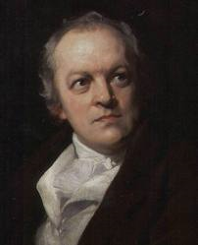
William Blake
Poet, Artist, Visionary

Slide 2
Single-handedly given credit for ending an era and influencing Romanticism
Is considered a poet, painter, and engraver (often all 3 were in one book)

Slide 4
Philosophy
Our way of life is founded on mistaken beliefs, leading to war and poverty
We only know a small part of our reality through our 5 senses
We must learn to trust our instincts/intuitions, energies, and imaginations
**Blake felt that we only concern ourselves with scientific truths and materialistic values**

Slide 5
Poet of Contrary?
Called “mad” = later declared a genius
Worked tediously by hand=industrial revolution
Emotional=age of reason
Simple theme=ornate styles

Slide 6
Major works
Songs of Innocence
Songs of Experience
**Companion volumes showing “2 contrary states of human experience.”

Slide 8
Innocence
Joy, spontaneity, and oblivious to evil
May discuss evil but not aware of its existence

Slide 9
Experience
Destruction of the state of innocence because it leads to awareness of evil and ugliness (not all doom and gloom, though)
Blake NEVER meant to suggest that one was better than the other. Rather BOTH are necessary to reach a third, optimal state

Slide 10
Organized Innocence
An existence based on knowledge of contraries and happiness
“Without contraries there can be no progression”
**Must pass through both innocence and experience to arrive at an existence based on knowledge and happiness.

Slide 11
“Without contraries there can be no progression”
What does this mean???

